Slide 1

Why do Icebergs float ?
Presented by Shailesh Kumar
M.sc. Electrical Engineering and Information Technology

Slide 2
Contents
Introduction
Physical Behaviour
Chemical bonding of water and ice
Conclusion
References

Slide 3
Introduction
Ice shelf or a glacier breaks off and enters into the ocean that forms a massive Iceberg.
The Icebergs formed with freshwater[1].
Flotation does not depend on the mass of the body.

Slide 4
Physical Behavior
Anomalous behavior of water
Water density is not constant at all temperatures.
Density of water keeps increasing with a
decrease in temperature till 4 degree centigrade [2].
Hence the density of ice is measured less as than the water.

Slide 5
Archimedes’ Principle
Liquid exerts buoyant force in an upward direction.
Force on a body immersed in a fluid is equal to the weight of the fluid that displaced by the body.

Slide 6
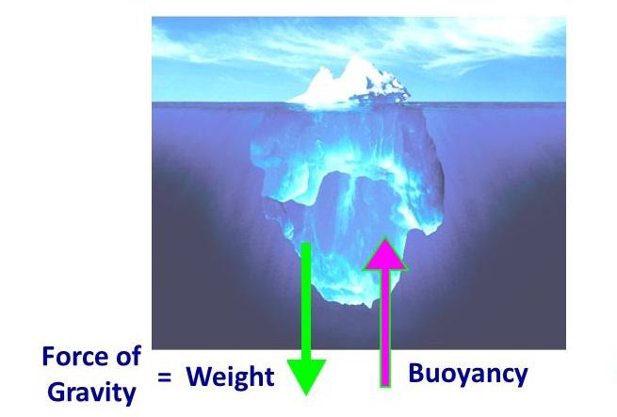
Buoyance force, F = Weight of the fluid displaced, W
90 percent of its part into the water, only 10 percent one can see from outside[3].
Shapes and sizes of icebergs:Dom, tri-angular, tabular etc.

Slide 7
. Ocean water is denser than fresh water. . Iceberg formed with the freshwater contains no impurity is less dense.
Density of different states of water
Density = Mass/Volume (gram per cubic centimeter)
Density of water at different temperature
Ocean water(0 deg) | Fresh water( 20 deg) | Ice(-20 deg)
1.03gm/cc | 1gm/cc | 0.92gm/cc

Slide 8
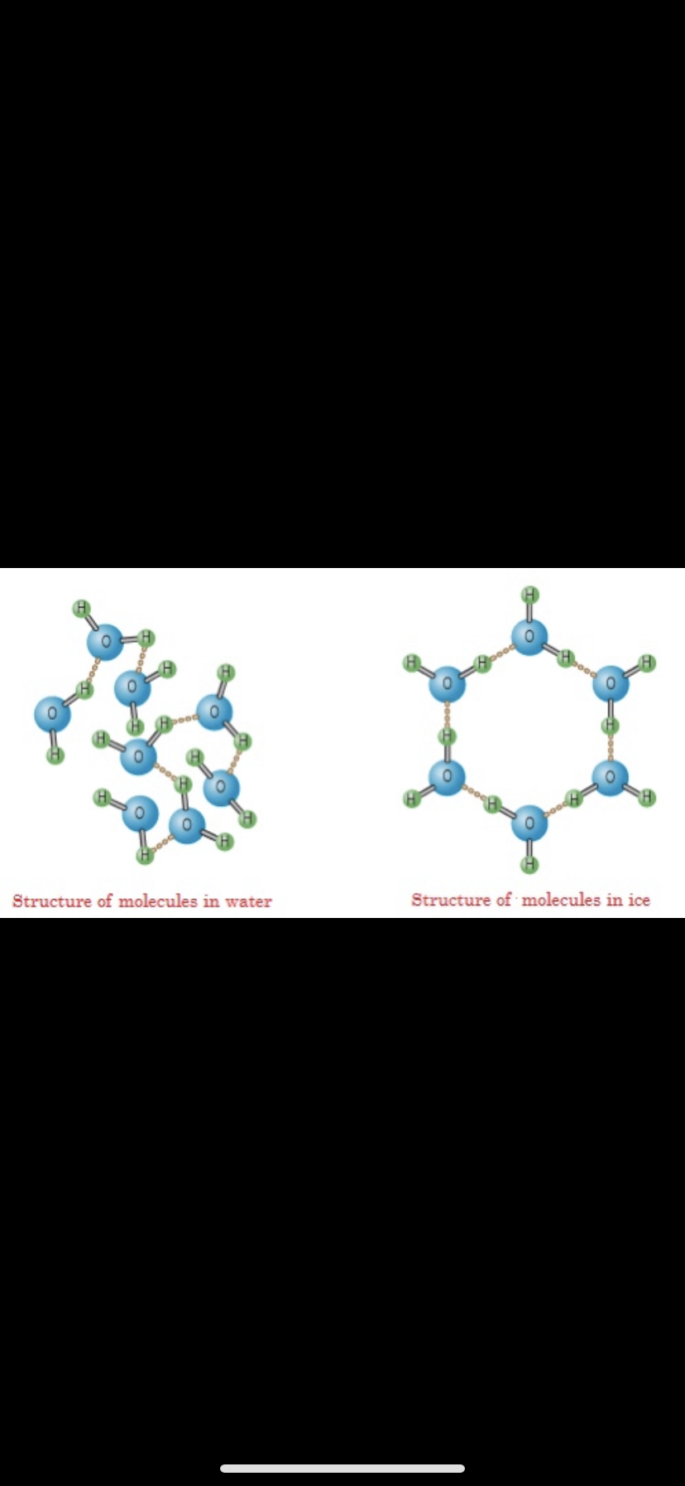
CHEMICAL BONDING OF WATER AND ICE
Crystalline structure of the water molecules.
Crystalline structures are lighter compared to the normal structure of the same molecules.
Air that is filled between empty spaces increases the volume, and decreases the density of Ice-cube [4].

Slide 9
Conclusion
The objects which are denser than water will sink and the objects which are less dense compared to water will float.
Iceberg is formed with freshwater.
Icebergs can make dangerous impact on shipping and other marine activities.

Slide 10
References
[1] Why do icebergs float ? sep 2017, https://www.livescience.com/32110-why-do-icebergs-float.html
[2] Why does ice float on water, 2019, https://www.sciencefacts.net/whydoes-ice-float-on-water.html
[3] Andrew Morris, “Why icebergs float: Exploaring science in Everyday life”. 2016 https://www.jstor.org/stable/j.ctt1gxxpgr
[4] Ice Ih, 2019, https://en.wikipedia.org/wiki/Ice_Ih

Slide 11

Thank you for your Attention!

